Slide 1


Using Machine Learning Methods to Predict Global Maternal Mortality Ratios
Rosalita Rosenberg¹, Minh Bui¹, Nhung Nghiem²
¹ School of Computing, Australian National University, Canberra, ACT
² John Curtin School of Medical Research, Australian National University, Canberra, ACT
AHES, Canberra, 12th September 2025

Slide 2
Acknowledgement of the country
I would like to begin by acknowledging the Traditional Owners and Custodians of the land on which we meet today. I would also like to pay my respects to Elders past and present, as well as to emerging leaders. I extend that respect to Aboriginal and Torres Strait Islander peoples who may be here today.

Slide 3
Outlines
Background
Aims
Methods
Preliminary Results
Discussion and Conclusions

Slide 4
Background
The United Nations Sustainable Development Goals (SDG) outline the international community’s aspiration to reduce the global maternity mortality ratio (MMR) to below 70 maternal deaths per 100,000 live births by 2030.
However, as of 2023, the average global ratio at 197 deaths per 100,000 live births remained significantly above the target.
Only a small subset of countries is projected to meet the SDG due to high country-level inequity (~95% of maternal deaths occur in LMICs)

Slide 5
The World Health Organization (WHO) has highlighted:
how limited access to accurate, complete maternal mortality data hinders effective interventions
especially as countries with the highest MMRs tend to have the most missing data.

Slide 6
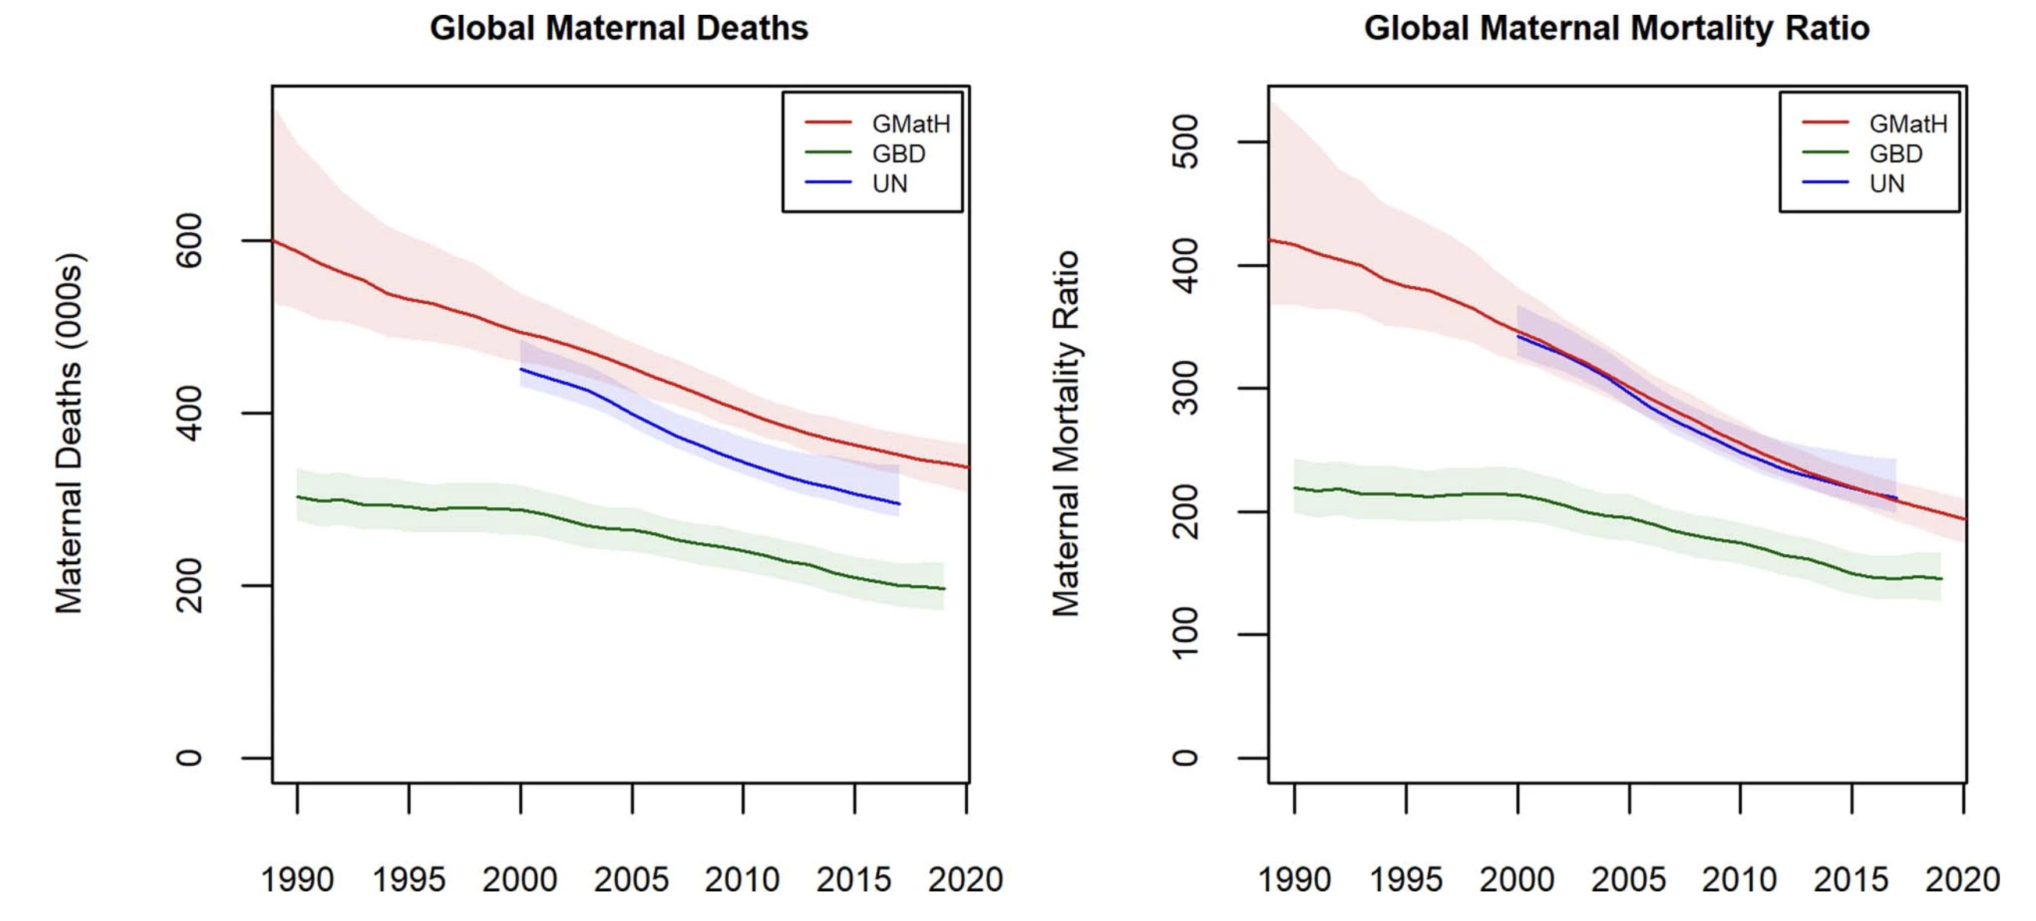
Ward et al 2023 Nature Medicine
Notes:
Lack of agreement

Slide 7
Motivation
Provide an alternative method for estimating and forecasting countries’ MMR using interpretable machine learning methods and a wider variety of dependent feature variables than used by the UN MMEIG and GBD Study.
These estimations and forecasts can be used to inform policy.

Slide 8
Aims
To predict the MMR for different countries between 1985 and 2018 using a mixture of socio-economic and health-related data sourced from the World Bank and World Health Organisation.
To identify the variables with the highest predictive power for the MMR, thus highlighting potential important areas that public health policies can target to reduce MMR.

Slide 9
Methods
We merged data from the World Bank’s Gender Data Portal and the WHO’s Health Inequality Data Repository that was collected between 1985 and 2018.
The final merged dataset contains 2789 observations and 721 features and covers 172 countries.
Variables (features) including country income level, ’mortality rate, infant (per 1,000 live births)’, and cause-specific mortality rates, as well as a variety of other socioeconomic, environmental and health-related indicators.

Slide 10
Summary information about the datasets used in this study.
Type of Dataset | Number of Features | Date Range | Number of Areas Covered | Demographic Subsets Chosen from Dataset | Source
MMR modelled and estimates | 2 | 1985-2023 | 242 | NA | World Bank Group’s Gender Data Portal
Overall health literacy, metrics, agency | 198 | 1960-2023 | 265 | NA | World Bank Group’s Gender Data Portal
Illness incidence and prevalence | 193 | 2000-2019 | 194 | Sex | WHO Health Inequality Data Repository & IHME
Empowerment | 9 | 1991-2023 | 120 | Economic status | WHO Health inequality Data Repository after re-analysis by the WHO Collaborating Center for Health Equity Monitoring
Socioeconomic, education, environmental | 64 | 1970-2023 | 195 | Sex, economic status, residence (urban, rural) | WHO Health Inequality Data Repository, sourced from The World Bank Data Catalogue
Income level | 1 | 2024 |  | NA | WHO Health Inequality Data Repository, produced by the WHO’s Global Health Observatory

Slide 11
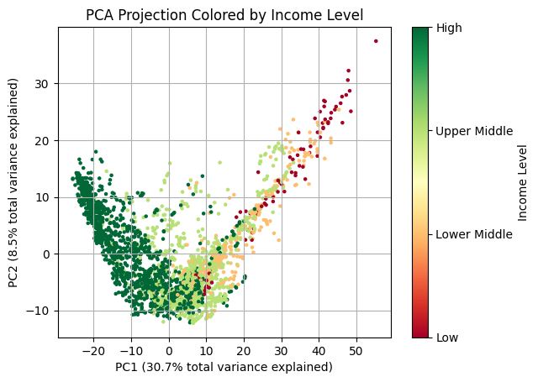
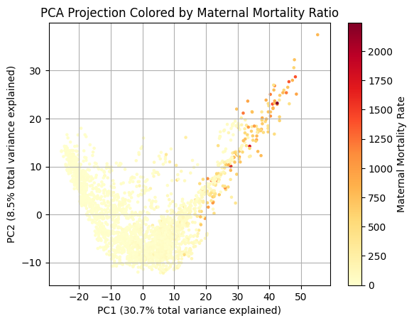
Principal component analysis (PCA) showing clustering by income level and MMR, with the highest income countries clustered similarly to the lowest MMRs

Slide 12
Summary Statistics
Country by income level | Number of observations | Women participating in own health care decisions (% of women age 15-49), Median | Mortality rate, infant per 1000 live births | Survival to age 65, female (% of cohort)
Low income | 78 | 59.5 | 64.8 | 57.6
Lower middle income | 310 | 66.7 | 39.3 | 73.1
Upper middle income | 996 | 84.1 | 19.4 | 80
High income | 1405 | 91 | 6.9 | 88.3

Slide 13
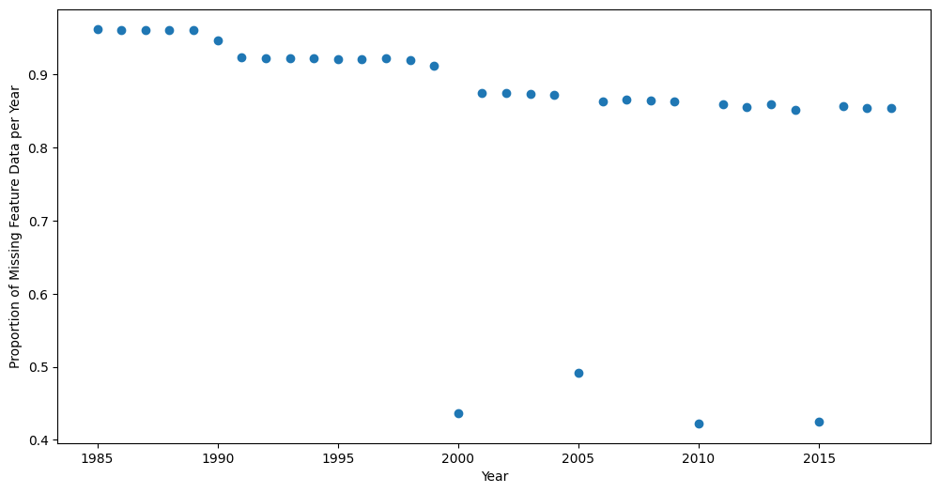
We tested different combinations of pre-processing, i.e., missing data thresholding.

Slide 14
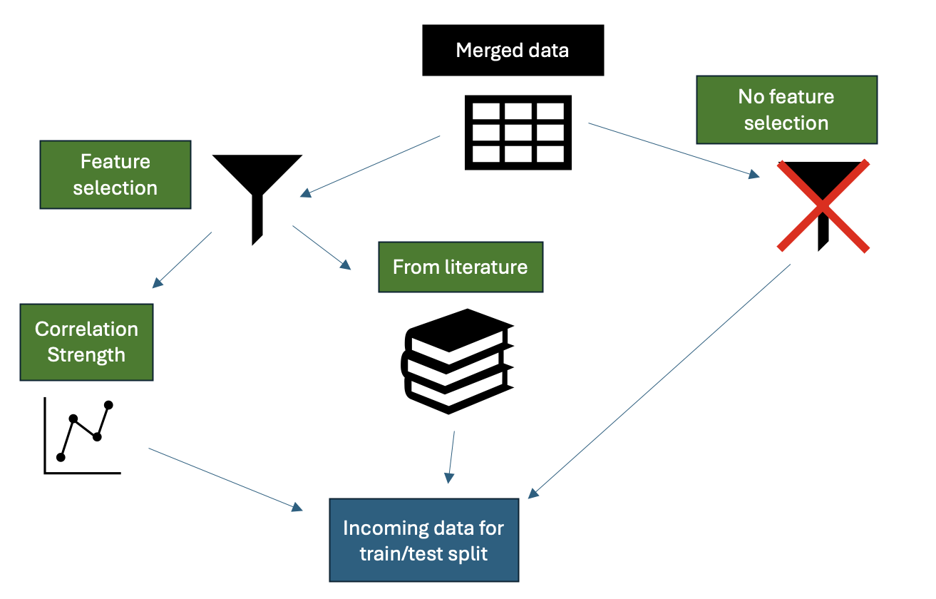
We also performed features selection

Slide 15
Modelling techniques
Split the 5 versions of the dataset (each of the feature subset versions and no feature subsetting) into train test sets in a 90:10 split by either splitting by year or by country.
Split these train sets into train/validation sets using 5-fold cross validation in an 80:20 ratio, again either by country or year (where the same year or country was either all in the train set or all in the validation set).
Apply each level of missing data removal to each of these folds.
Models’ hyperparameters using 1000 Optuna trials.

Slide 16
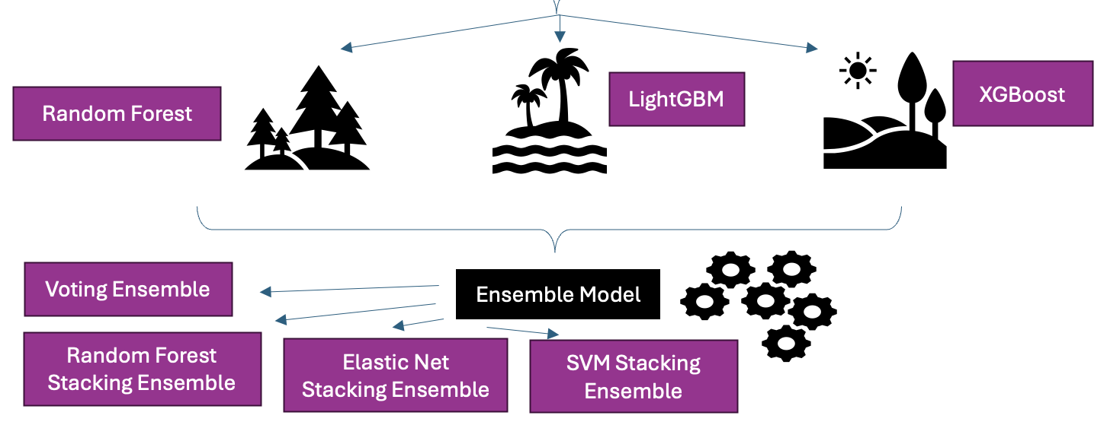
ML models employed

Slide 17
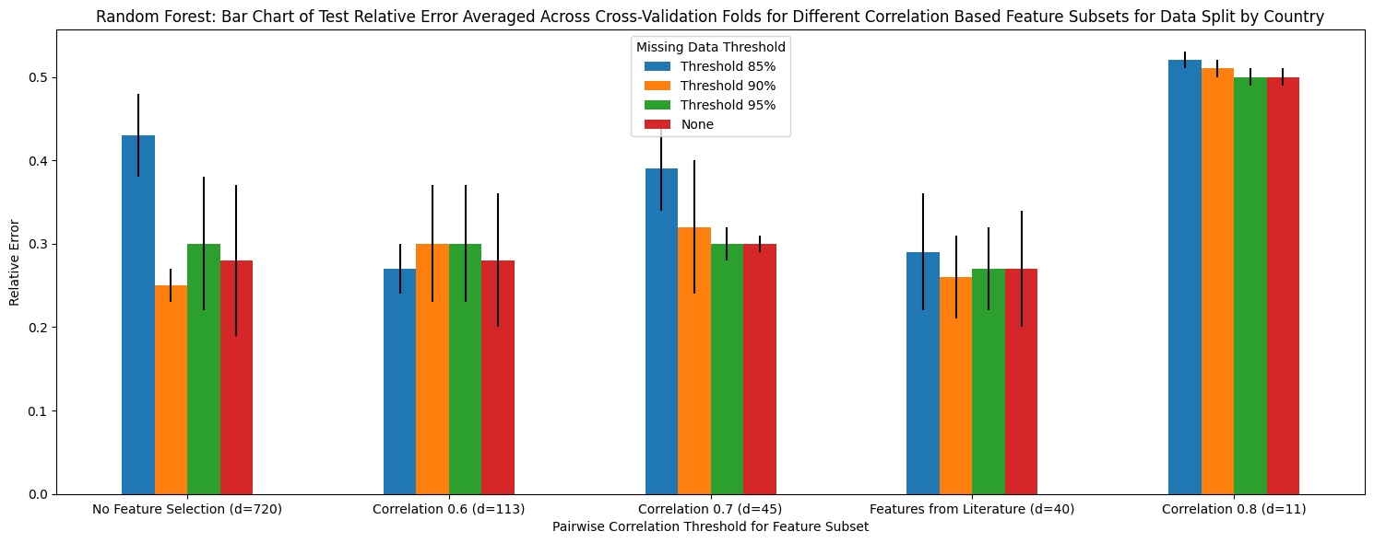
For example, the relative error of the base Random Forest model for different feature selections

Slide 18
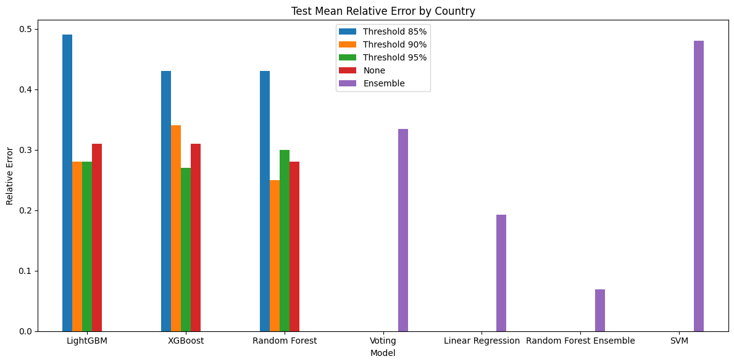
The random forest ensemble performs much better than all other base or ensemble models for the relative error metric

Slide 19
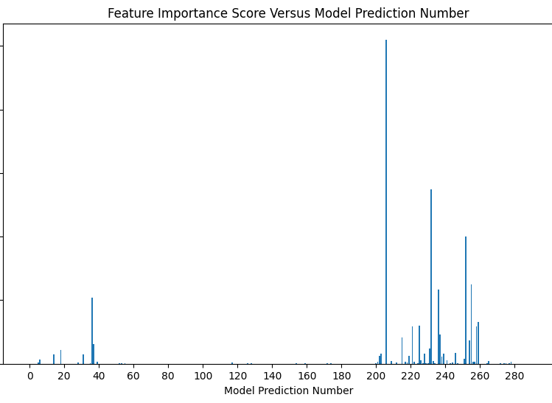
The random forest ensemble’s may be making smart predictions about which base estimator models to use
Feature importance is the mean ‘of accumulation of the impurity decrease within each tree.’

Slide 20
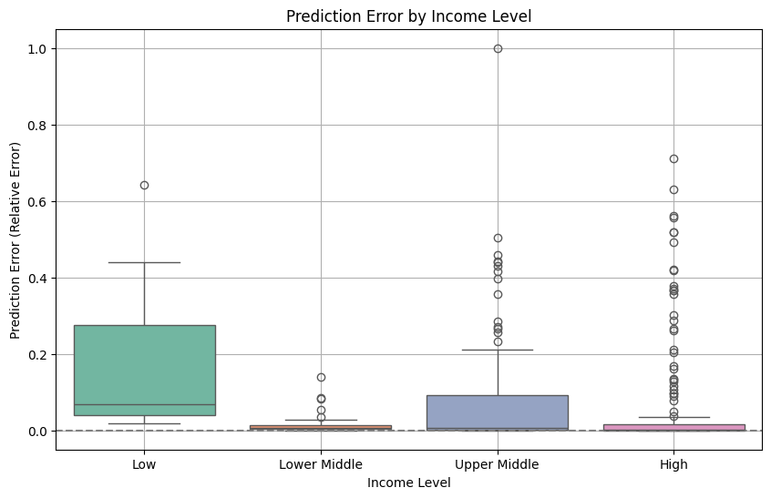
Relative error in random forest ensemble predictions versus income level for split by country.

Slide 21
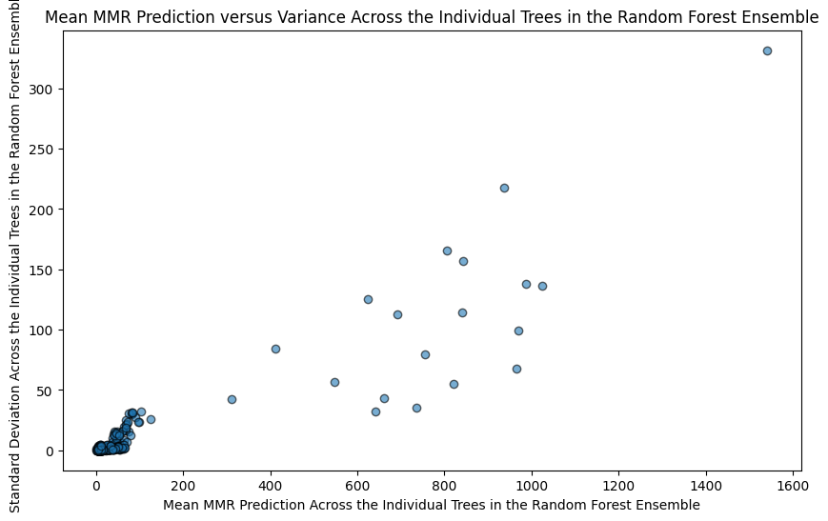
Standard deviation of base estimators versus mean base estimator prediction:
Standard deviation increases as MMR increases, reflecting the model’s lack of certainty when predicting high MMR.
- Reflects the small amount of data available for (lower income) higher MMR countries

Slide 22
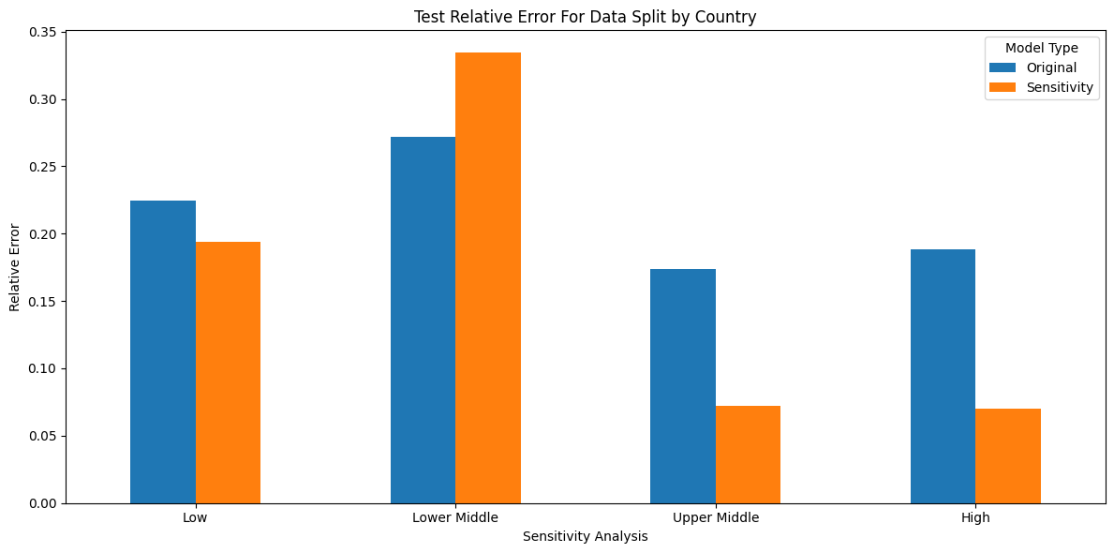
Sensitivity analysis for the final model (built models by income-level)
Notes:
Low income sensitivity does better because it has unique patterns
High does better without outliers due to noise in data (similar for upper middle)
Low income does worse because the model somehow learned important patterns in the original dataset, which it has now lost (potentially because of many different possible scenarios in a lower-middle income country)

Slide 23
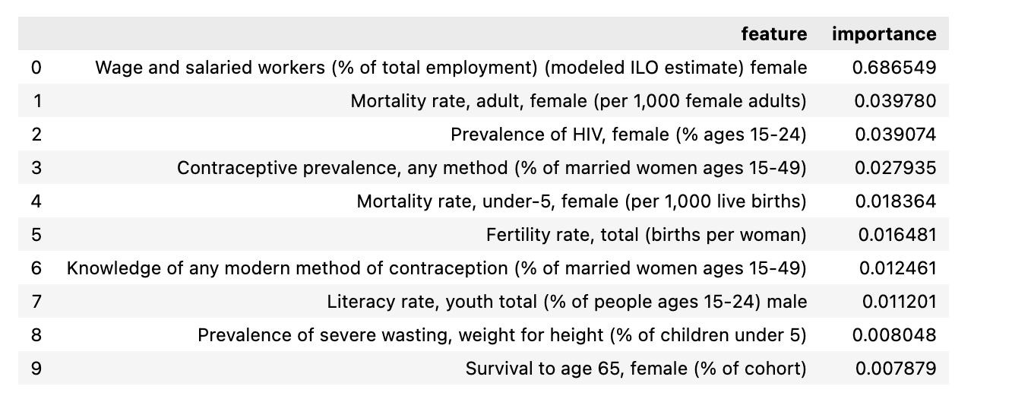
Most valued model by random forest ensemble Many of these features are valued in the literature (contraception prevalence, infant mortality, literacy, wasting, HIV)

Slide 24
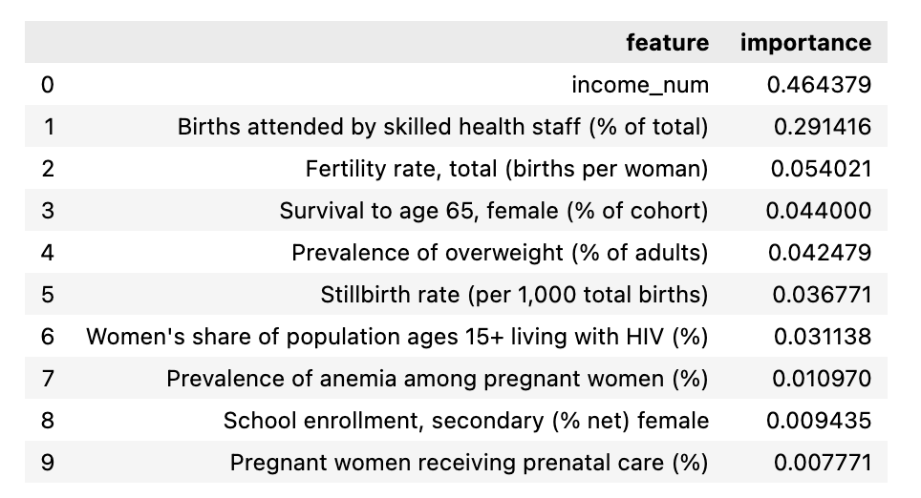
Second most valued model by random forest ensemble

Slide 25
Discussion
Main results:
The best model was the Random Forest Ensemble model
Our best model was able to predict MMR with relative error of 6% compared to the data observations.
Features of high predictive power were established risk factors (reinforcing policy priorities)
Strengths:
Various missing data and machine learning models were employed
Many dependent variables were considered
Compared to the literature (GBD, UN)

Slide 26
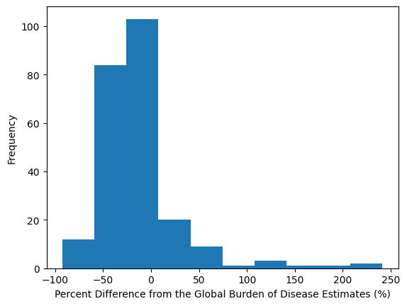
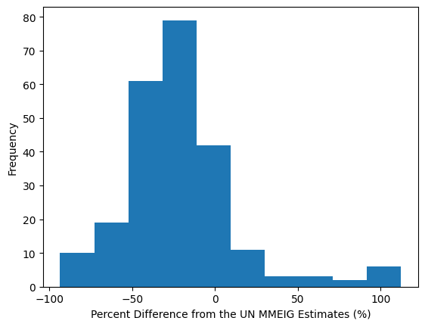
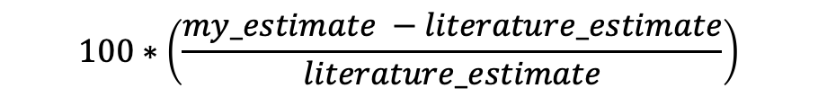
Comparison to Existing Literature Methods
$$100∗\left(\frac{my_estimate −literature_estimate}{literature_estimate}\right)$$
Notes:
Due to underreporting, as these models have specific mechanisms to deal with this

Slide 27
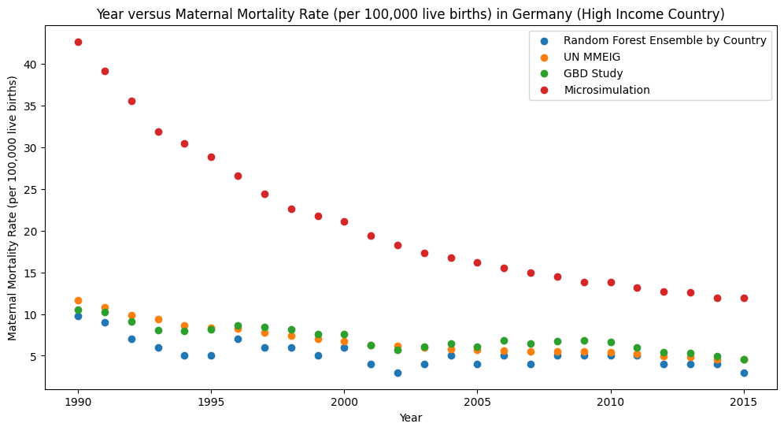
Comparison to Existing Literature Methods

Slide 28
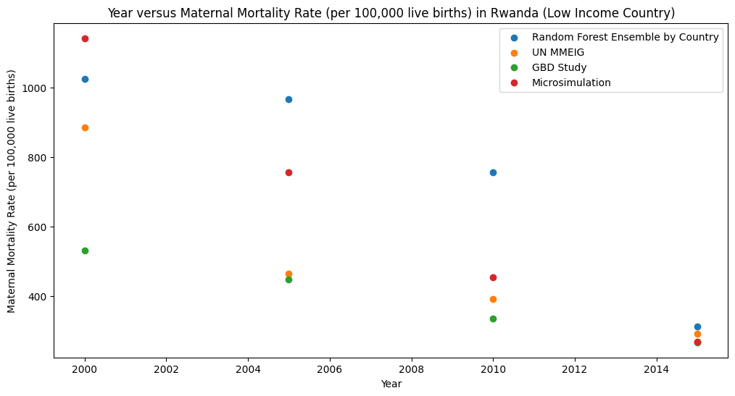
Comparison to Existing Literature Methods

Slide 29
Limitations:
Preliminary results
Data sparsity
Inconsistent data quality across countries
Inconsistent data quality across time periods

Slide 30
Conclusions
This study provides a tool for policy makers and public health practitioners to obtain MMR estimates across a range of years and countries by explicitly considering missing data and a wide range of socio-economic and health-related variables, allowing them to craft effective public health interventions.
It also provides a methodological framework for training ML models to predict similarly critical public health metrics.
Future study: potential secondary model to correct for underreporting

Slide 31
Thank you
Rosalita Rosenberg: rosalita.rosenberg@anu.edu.au
Minh Bui: minh.bui@anu.edu.au https://anu-phylogenomics.github.io/
Nhung Nghiem: nhung.nghiem@anu.edu.au

